Slide 1

Deepfake detection
Presented by
Gayathry
N01620436

Slide 2
Introduction
Deep Learning
Hyper realistic manipulated media (video, audio, or image) created using Artificial Intelligence (AI)
Deep Fake
Entertainment
Gaming
Virtual Reality
Computer Vison
NLP
Education
Applications
Misinformation
Frauds & Scams
Identity Theft
Revenge porn
Security Issues
Risks

Slide 3


Methodology
Source: Kaggle deepfake detection challenge Size : 2.14GB
400 videos with a meta-JSON file
400 videos for testing
Data split: 80-20 ratio
InceptionResNetV2
VGG19
CNN
Xception
Data Set
Data Pre-processing
Data modelling
Tuning & Testing
Key Stages:
Data preparation
Feature extraction
Classification
Accuracy
F1 score
Precision
Recall
Specificity

Slide 4
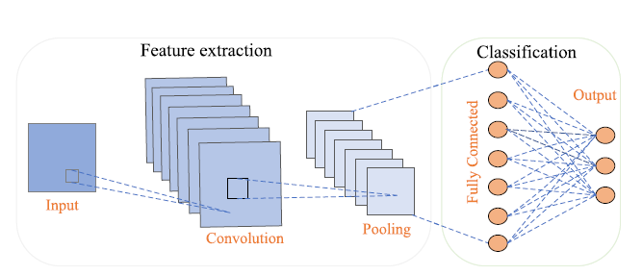
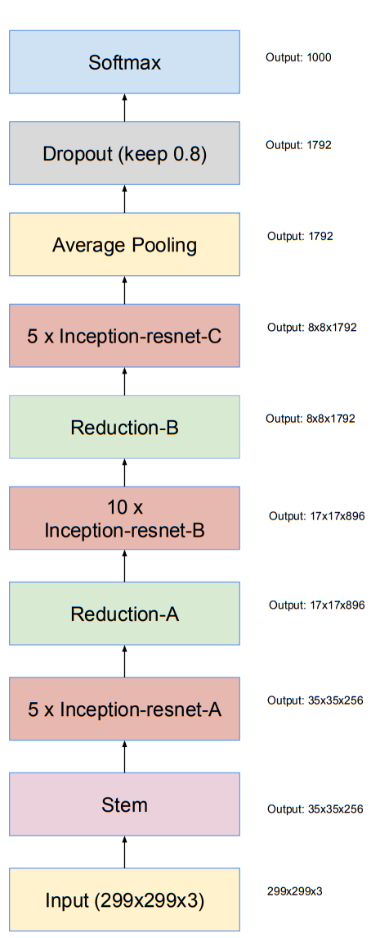
Model Architecture
CNN
InceptionResnetV2
VGG19
Xception

Slide 5

Architecture Advantage
Combines Inception and ResNet
Improves feature extraction while reducing computational cost
Detects fine grained details
InceptionResNetV2
Deep architecture with 19 layers
Helps in learning intricate textures and facial patterns
Simple but powerful
VGG19
Well suited for image classification
Fast and accurate feature learning
Customizable architecture allows for domain-specific tuning
CNN
Use depth wise separable convolutions
Improved efficiency and accuracy
Excels in detecting subtle artifacts
By focusing spatial correlations
Xception

Slide 6
Fine Tuning and Testing
Hyperparameters | Values
Optimizer | Adam
Loss Function | Categorial_Cross entropy
Image size | 128*128
Batch size | 64
Epochs | 50
Patience | 3
Activation | Softmax, Relu
Verbose | 1
Metrics | Accuracy, Precision, F1 Score, Recall, Specificity

Slide 7
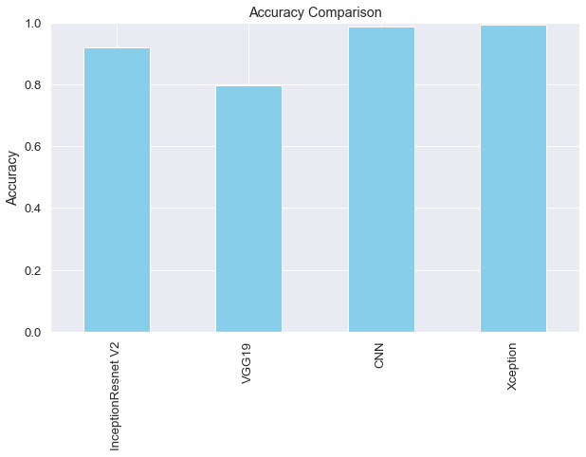
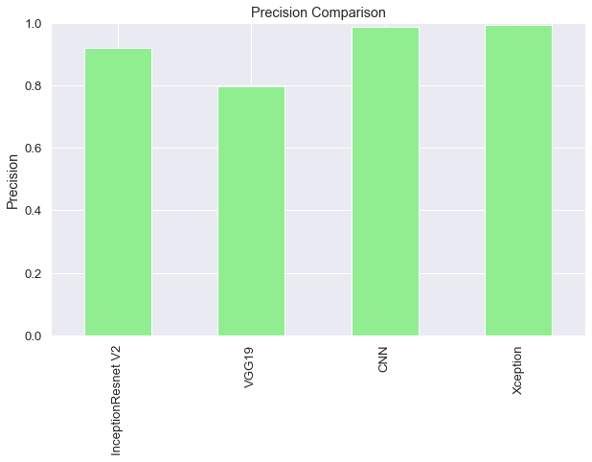
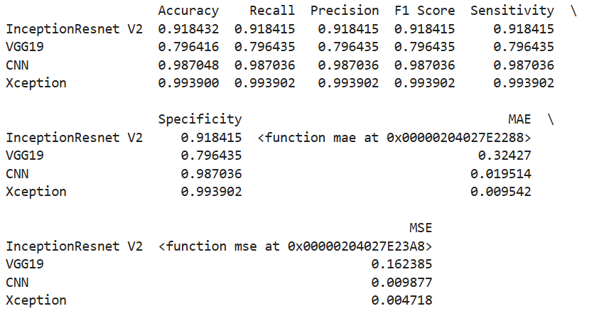
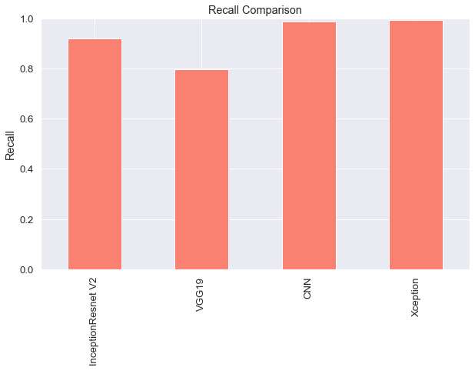
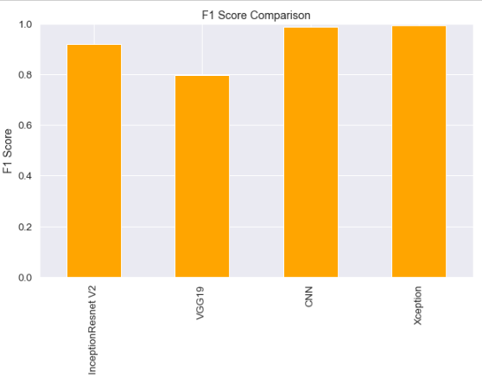
Evaluation of Results
Accuracy = TP + TN) / (TP + TN + FP + FN)
Precision = TP/(TP+FP)
Recall = TP / (TP + FN)
F1 score = 2 * (Precision * Recall) / (Precision + Recall)
Specificity = TN / (TN + FP)

Slide 8
Conclusion & Future scope
91.8%
InceptionResnet V2
Future Scope
Hybrid Models
Blockchain Technology
Quantum Neural Networks
79.6%
VGG19
98.7%
CNN
99.3%
Xception

Slide 9
References
1. Verma, Akshay, Dipesh Gupta, and Manish Kumar Srivastava. "Deepfake detection using inception-ResnetV2." In 2021 First International Conference on Advances in Computing and Future Communication Technologies (ICACFCT), pp. 39-41. IEEE, 2021.
2. Hayathunnisa, V., P. Kuppusamy, and A. Manimaran. "Art of Detection: Custom CNN and VGG19 for Accurate Real Vs Fake Image Identification." In 2023 6th International Conference on Recent Trends in Advance Computing (ICRTAC), pp. 306-312. IEEE, 2023.
3. Lei, Xinyu, Hongguang Pan, and Xiangdong Huang. "A dilated CNN model for image classification." Ieee access 7 (2019): 124087-124095.
4. Joshi, Paritosh, and V. Nivethitha. "Deep Fake Image Detection using Xception Architecture." In 2024 5th International Conference on Recent Trends in Computer Science and Technology (ICRTCST), pp. 533-537. IEEE, 2024.

Slide 10
THANK YOU FOR WATCHING

